Slide 1
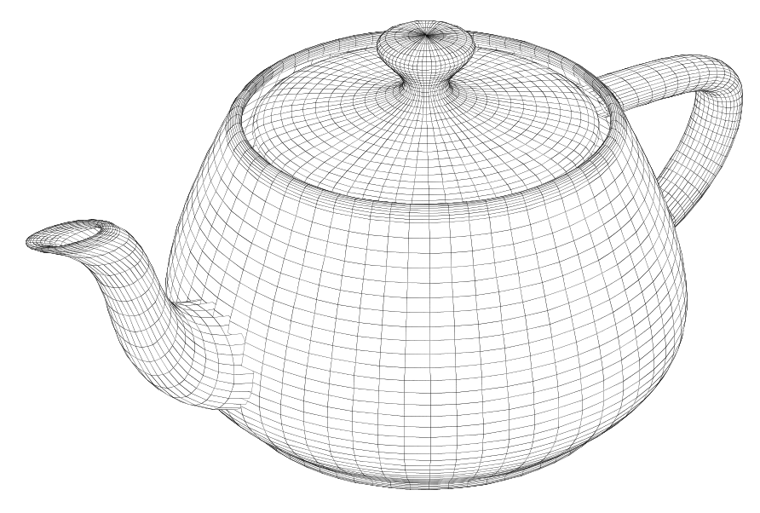
Curves
CSCI 440 Computer Graphics
material blatantly stolen from Chapter 11 of Angel's
Interactive Computer Graphics

Slide 2
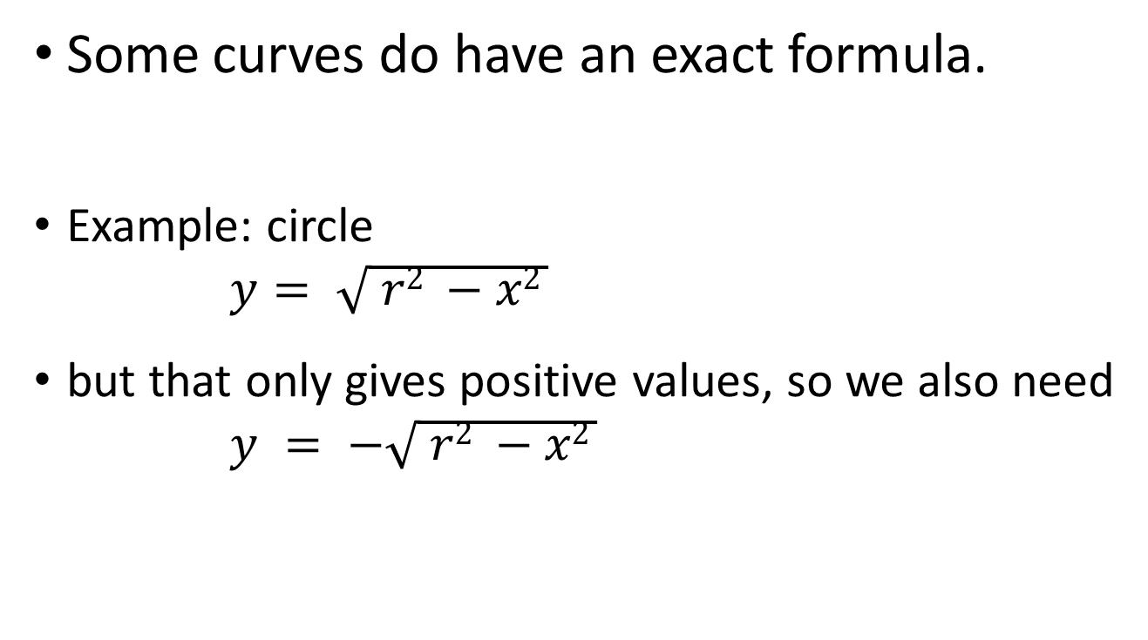
Explicit Representation
Some curves do have an exact formula.
Example: circle
$$y= \sqrt{ r2 −x2 }$$
but that only gives positive values, so we also need
$$y = −\sqrt{ r2 −x2 }$$

Slide 3
Explicit Representation
Some lines do have an exact formula.
Example: y = mx + b
But, what's the formula for this line:

Slide 4
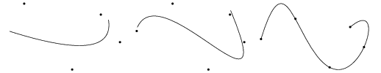
Parametric Polynomial Curves
We can form curves using control points to shape the curve.
The higher the order of the polynomial, the more control we have.
But the higher the order, the more time it takes to compute the points.
Cubic is the sweet spot.
uses 4 control points

Slide 5
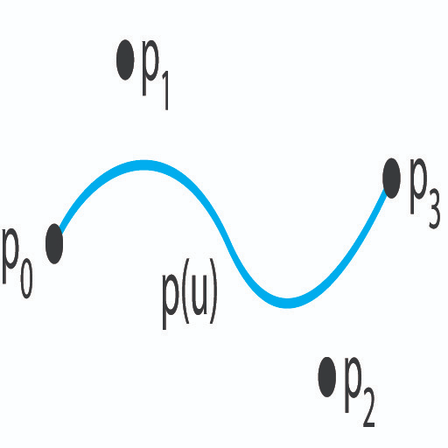
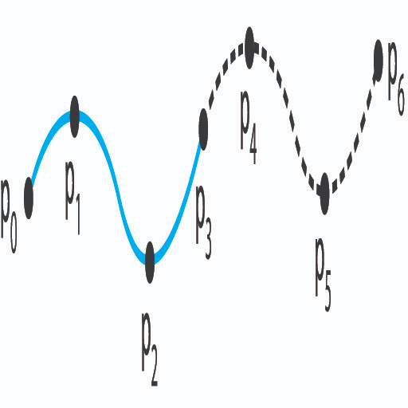
Parametric Polynomial Curves
There are several methods that use control points to create curves.
Hermite Curves
Bezier Curves
we just need to rotate and translate points (matrix math)
To build a more complex curve, break the curve into groups of four control points.
Angel figures 11.9 and 11.10

Slide 6
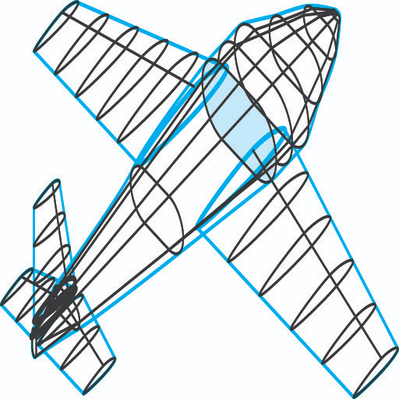

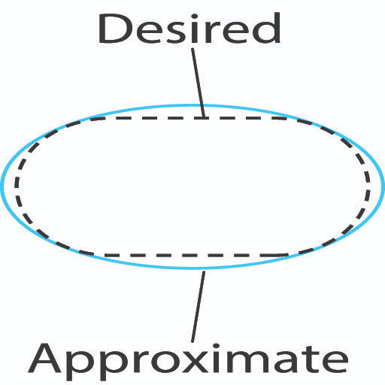
Example
Assume we want to model an airplane.
A cross section near the cockpit would look like:
We would probably break this into four curves and settle for this:
Angel figures 11.5, 11.6, and 11.7

Slide 7
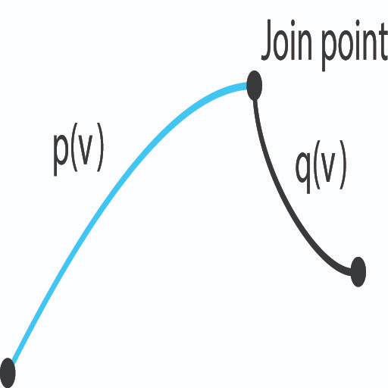
Problem
Sometimes when we break a curve into sections, we get:
Solutions include
Cubic B-Splines
Nonuniform rational B-Splines (nurbs)
uses weights to change the importance of particular control points
Angel figure 11.8

Slide 8
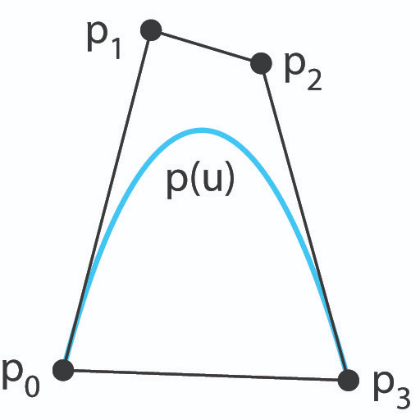
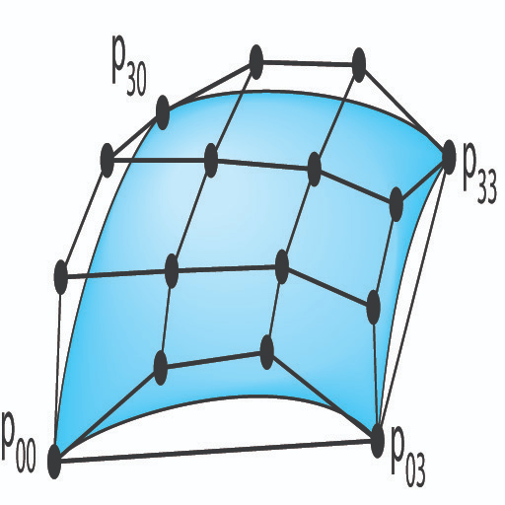
Bèzier Curves
B(u), as u goes from 0 to 1 =
(1 - u)³P₀ + 3(1 - u)²uP₁ + 3(1 - u)u²P₂ + u³P₃
Angel figures 11.19 and 11.20

Slide 9
Bèzier Curves
Two control points (linear)
Three control points (quadratic)
animations from wikipedia.com

Slide 10
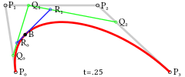
Bèzier Curves
Four Control Points (cubic polynomial)
Fifth Order
animations from wikipedia.com

Slide 11
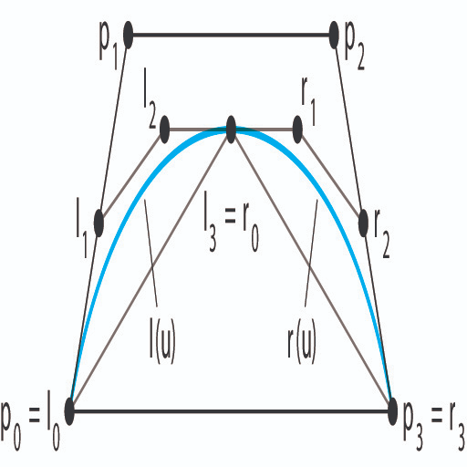
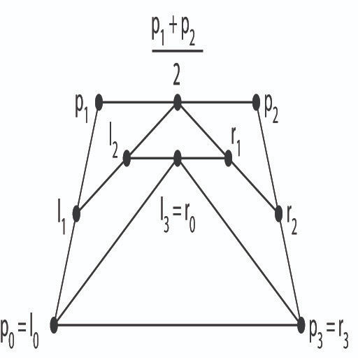
Recursive Subdivision
Angel figures 11.34 and 11.35

Slide 12
Recursive Subdivision
Example 1
Given the Control Points
[0,0] [5,5] [15,5] [20,0]
First subdivision yields:
[0,0] [2,2] [10,5] [17,2] [20,0]
Second subdivision yields:
[0,0] [1,1] [6,3] [13,3] [18,1] [20,0]
This operation uses only one addition and one bit shift.

Slide 13
Recursive Subdivision
Example 2
Given the Control Points
[0,0] [4,10] [12,15] [20,15]
First subdivision yields:
[0,0] [2,5] [8,12] [16,15] [20,15]
Second subdivision yields:
[0,0] [1,2] [5,8] [12,13] [18,15] [20,15]

Slide 14
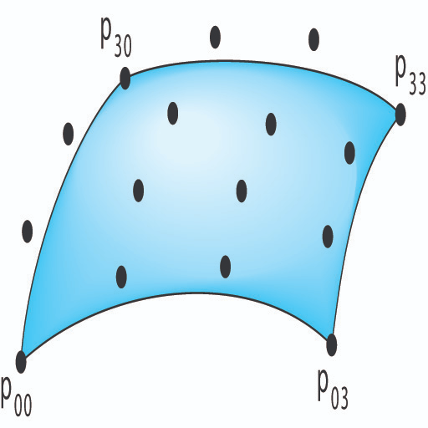
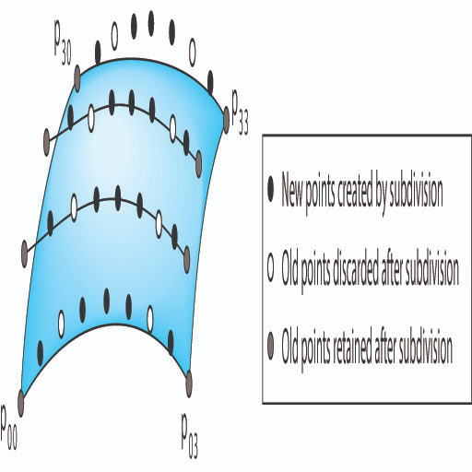
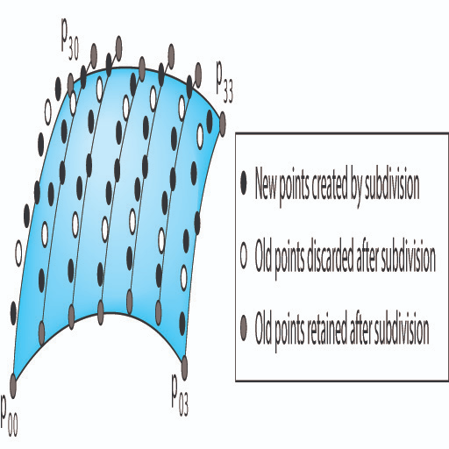
Recursive Subdivision
Angel figures 11.37, 38 and 39

Slide 15
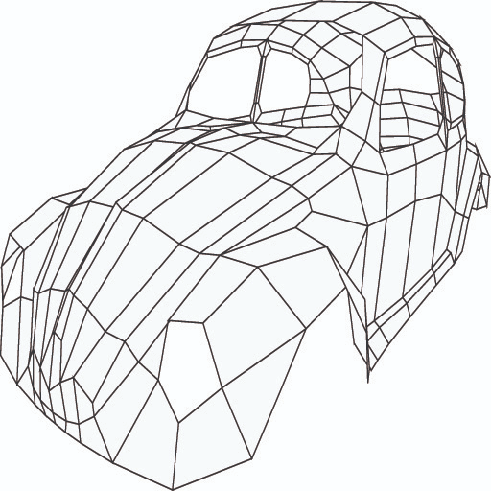
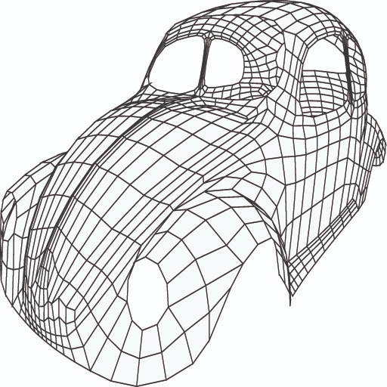

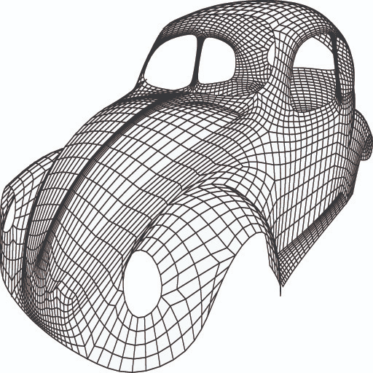
Recursive Subdivision
Angel figures 46A - 46D

Slide 16
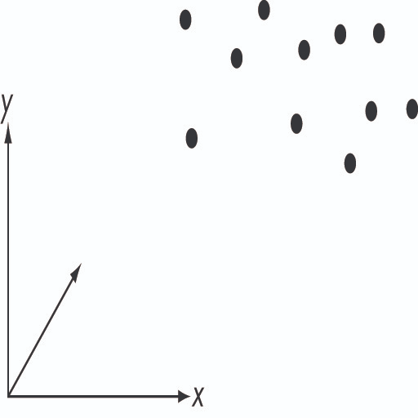
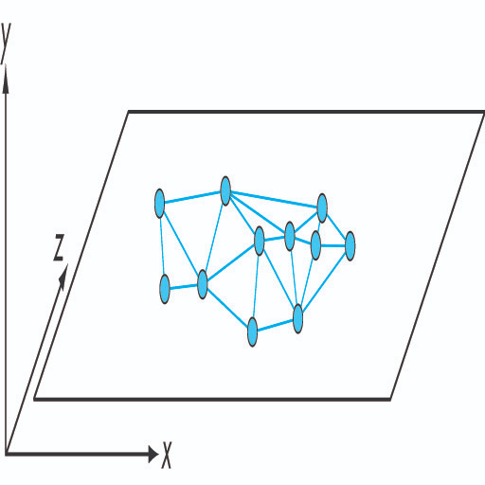
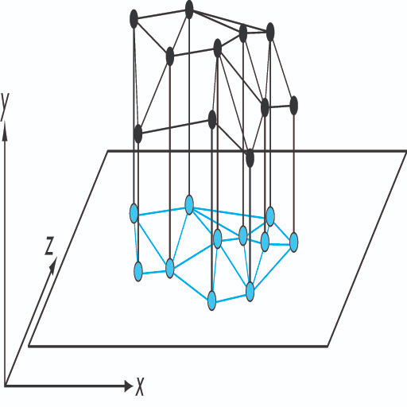
Building Meshes from Data Points
Delaunay Triangulation
Angel figures 11.47, 11.49, 11.50

